Slide 1

Emergency Preparedness for Blind/Low Vision
Oct 2025

Slide 2
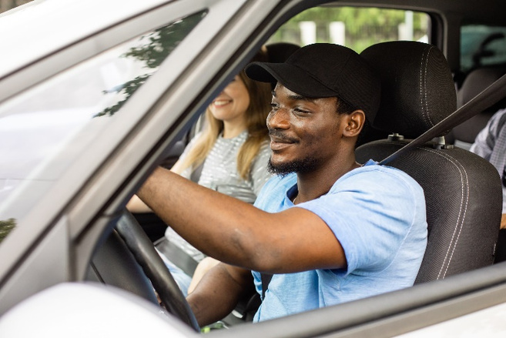


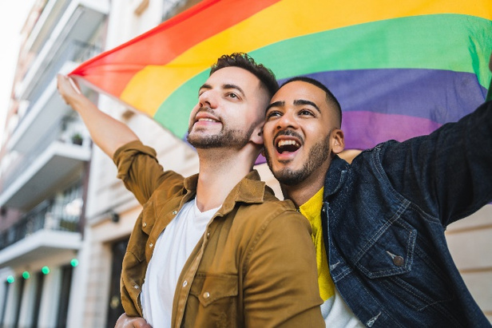
A preparedness program designed to educate and empower community members to prepare for, respond to, and recover from all types of emergencies, threats, and hazards.

Slide 3

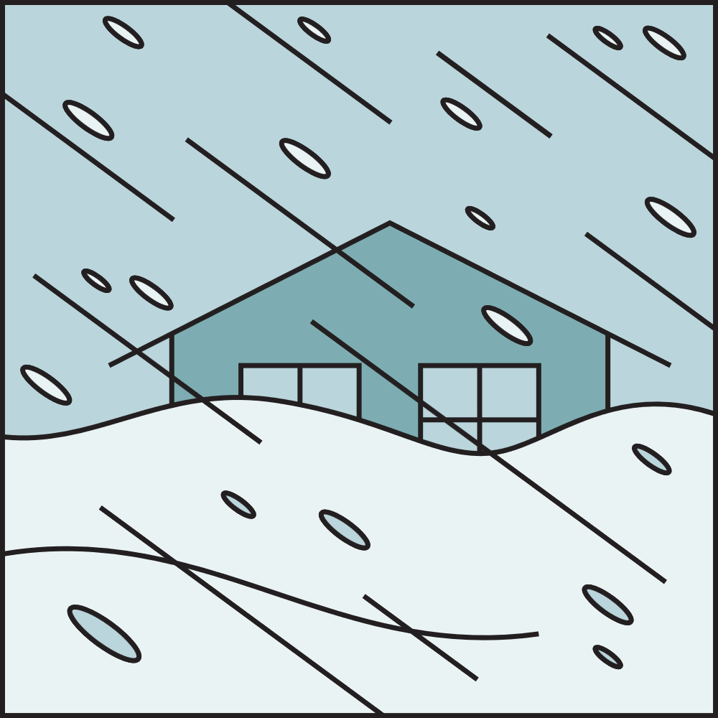
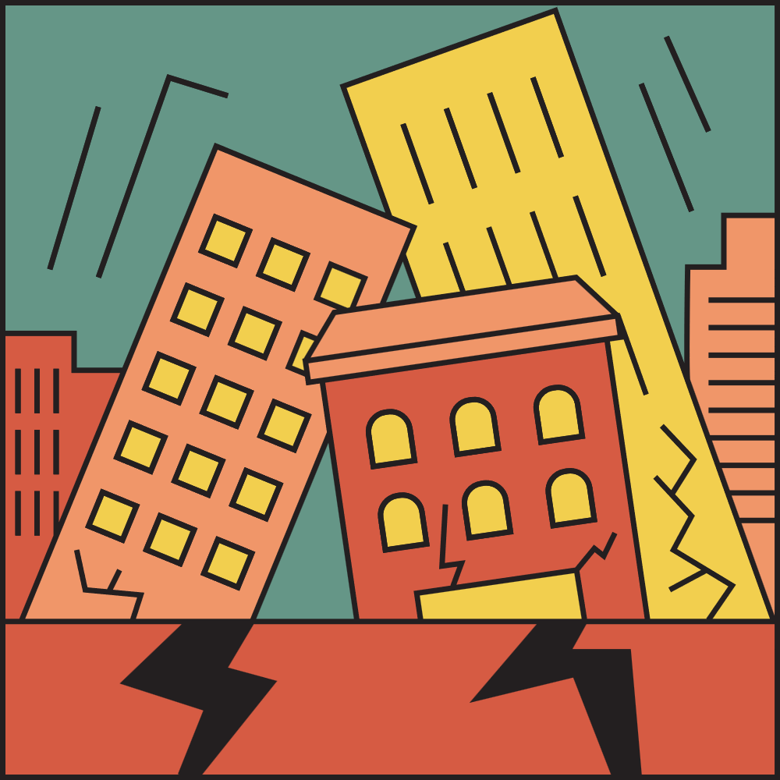
Common Terms
  Disaster
  Hazard
  Emergency
  Preparedness
  Watch
  Warning

Slide 4
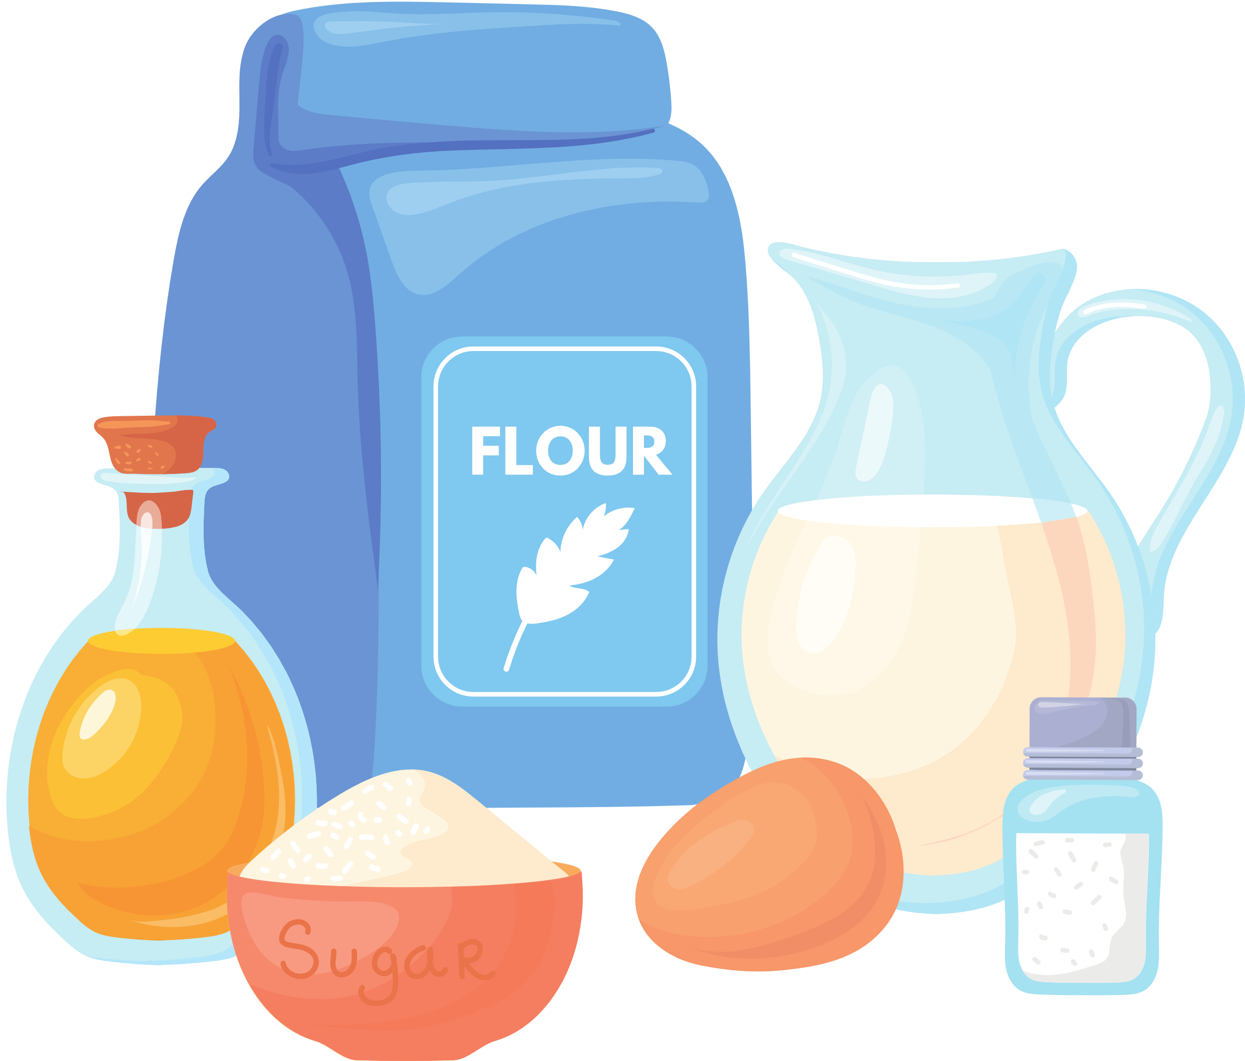


Watch vs. Warning

Slide 5
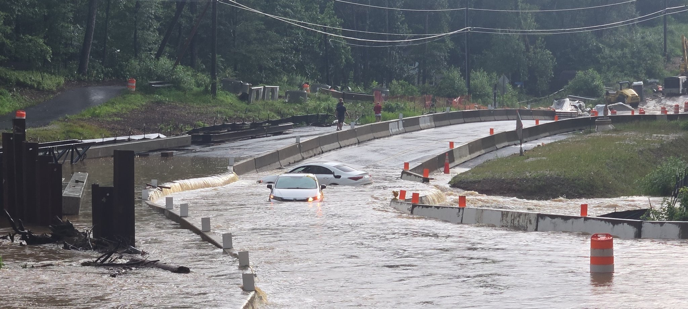
Fairfax County Hazards

Slide 6
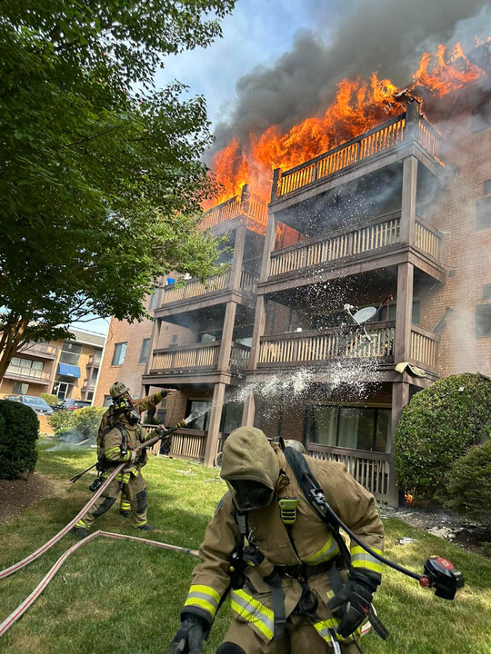
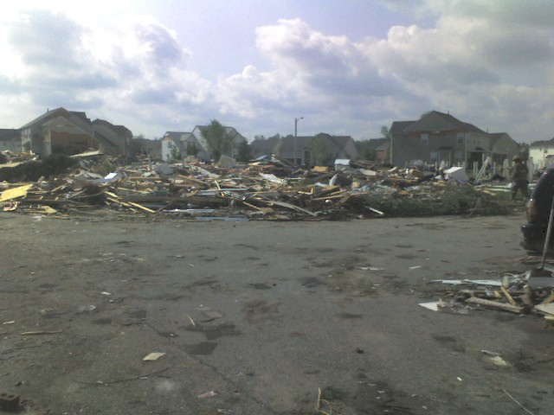
Fairfax County Hazards
  Thunderstorm
  Hurricanes
  Flooding
  Winter Weather
  Extreme Heat
  Tornado
  Earthquake

Slide 7
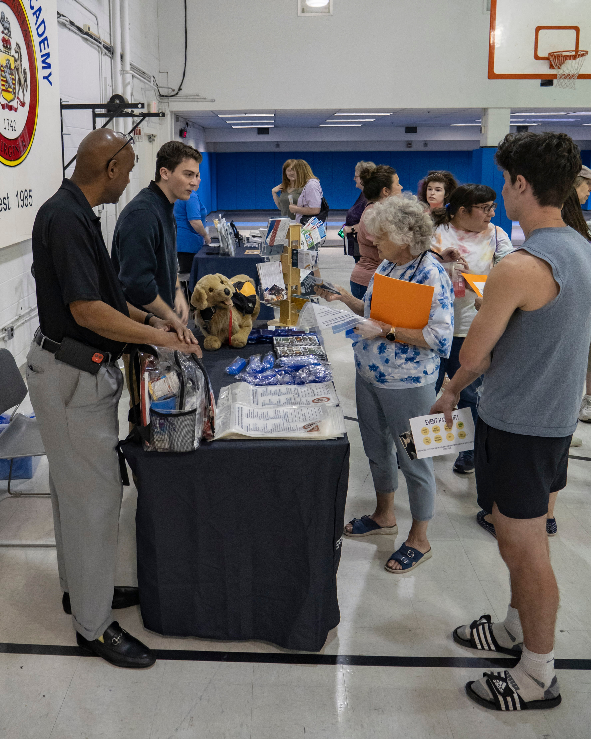
Preparedness Tips

Slide 8
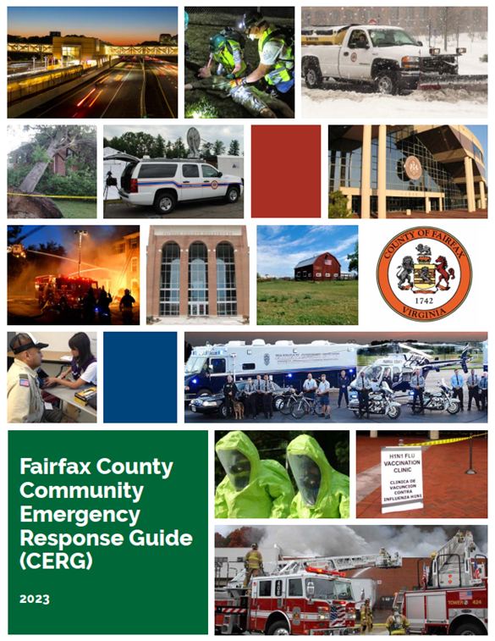
Community Emergency Response Guide (CERG)
  Create:
    Family Emergency Plan
    Emergency Kit
  Collect important contact information
  Learn actions to take before, during, and after an emergency
  How to get involved

Slide 9
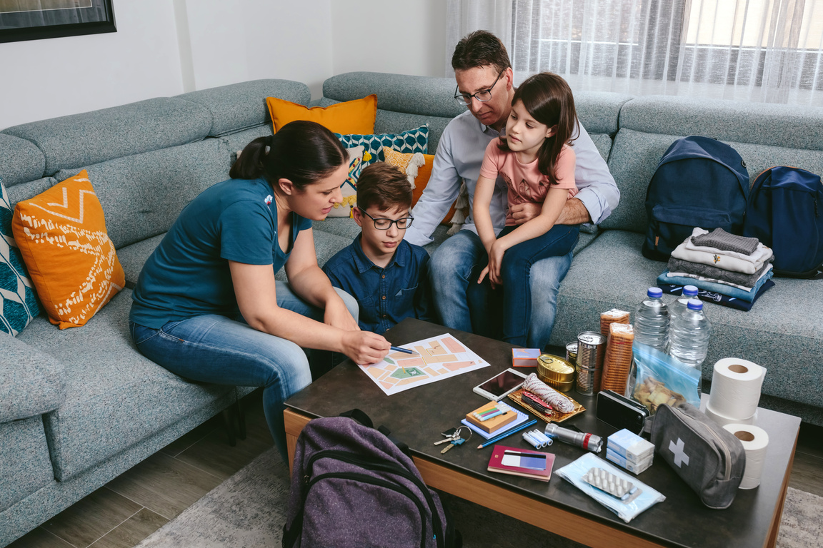
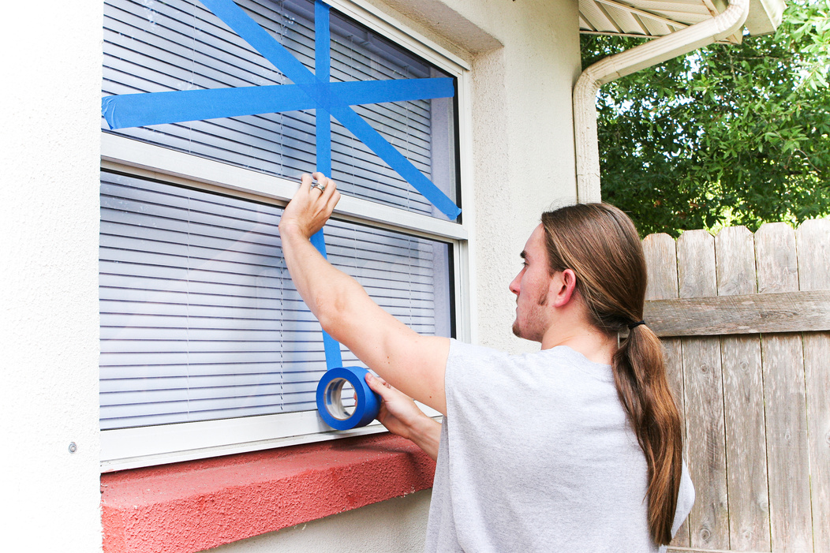
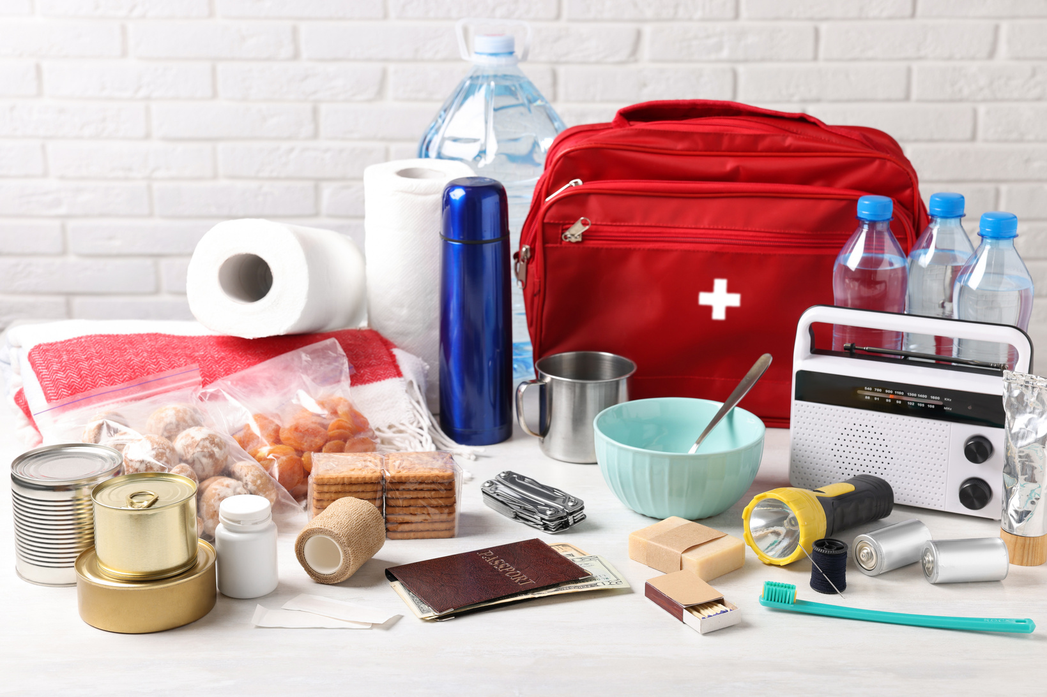


5 Steps
Make a Plan
Practice Your Plan
Create a Kit
Stay Informed
Get Involved!

Slide 10

Step 1: Make a Plan
  Contact information: family, friends, healthcare
  Important medical information
  Emergency meet up locations
  Emergency kit locations
  Pet considerations

Slide 11
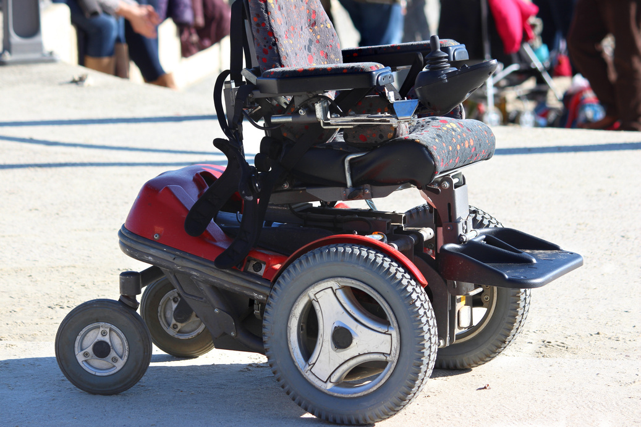

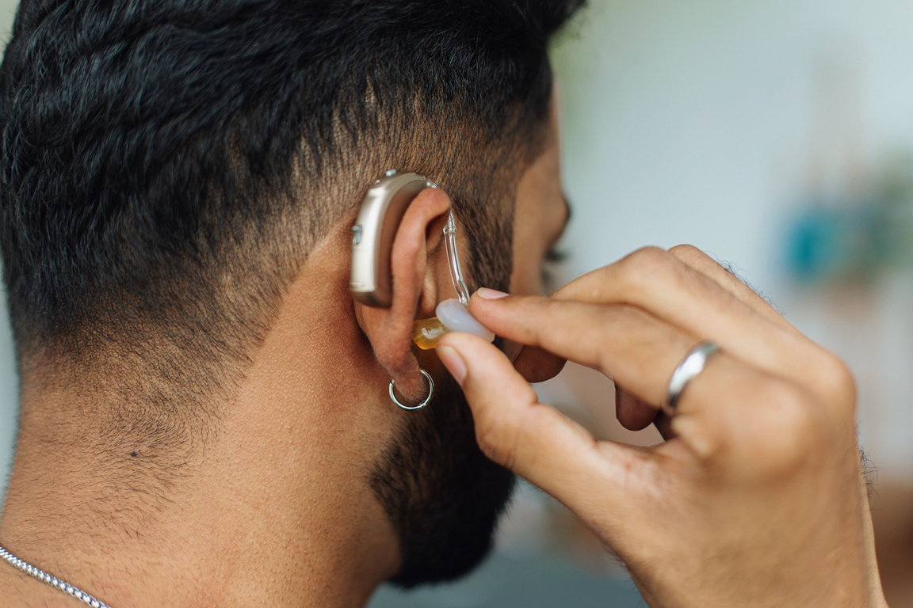
Disability/AFN Considerations
  Information on durable medical equipment (DME)
  Communication needs or special considerations for first responders, neighbors, or other support staff
  Multiple accessible routes (if possible)

Slide 12
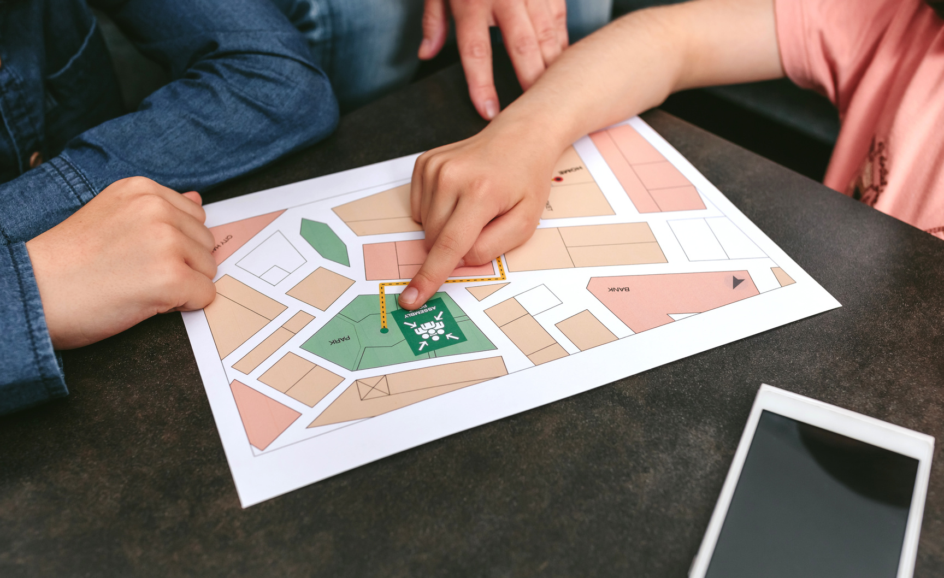
Step 2: Practice Your Plan
It’s important to practice your plan!
  Evacuation routes to leave your home
  How to get to your meeting spot
  Who and how to contact secondary emergency contacts

Slide 13
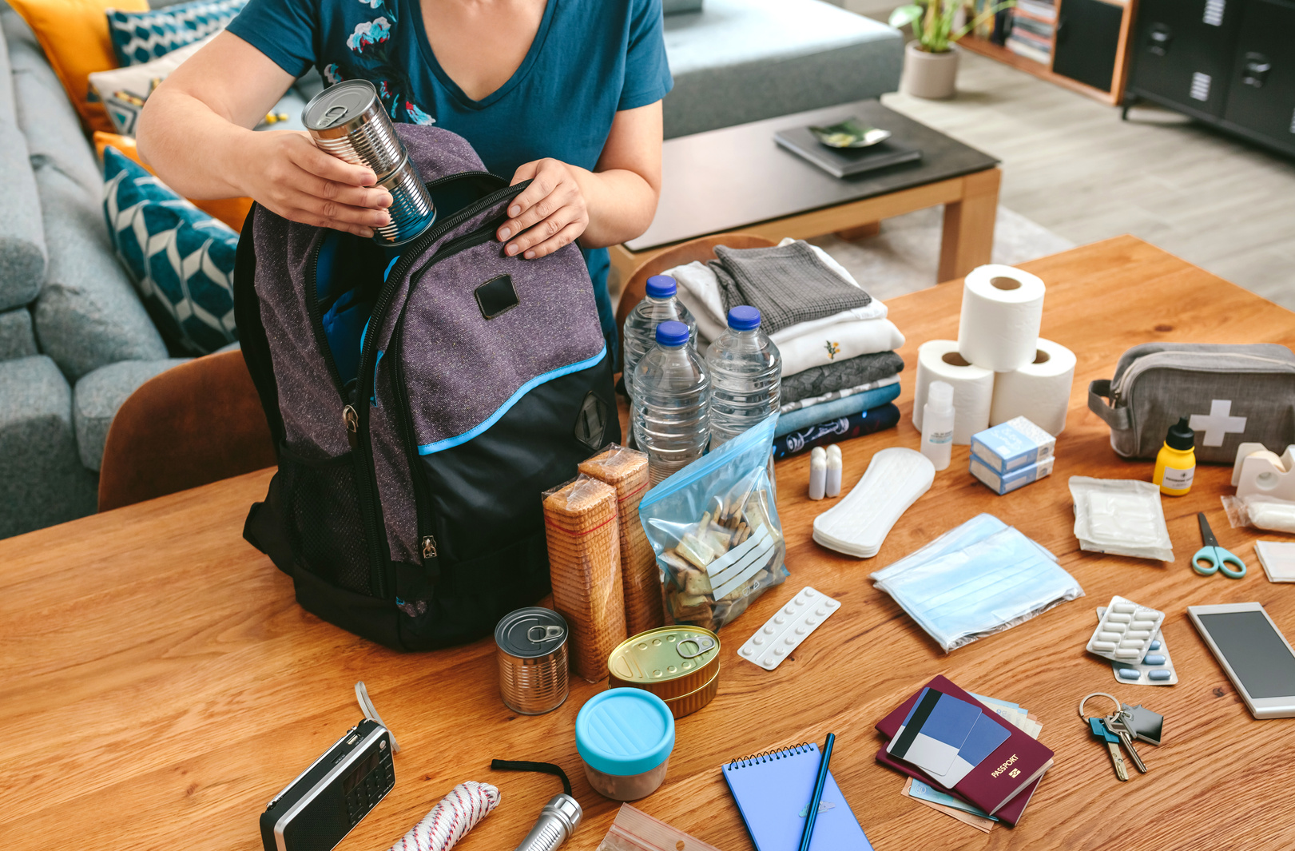
Step 3: Create an Emergency Kit
Your emergency kit should have what you need to be on your own for several days.
You can also make an emergency “go-bag” for easy access in the event of an evacuation.

Slide 14
What to put in your kit?
Food & Water
First Aid
Communication
  3-day supply of food and water for each person
  1 gallon of water per day per person
  Any pet food or specialty food
  Basic first aid kit
  All medications
  Hand sanitizer
  Paper towels
  Dental care
  Soap, personal hygiene
  Hearing & vision
  Radio w/batteries
  Chargers
  Flashlights
  Document bag
  Any assistive devices

Slide 15
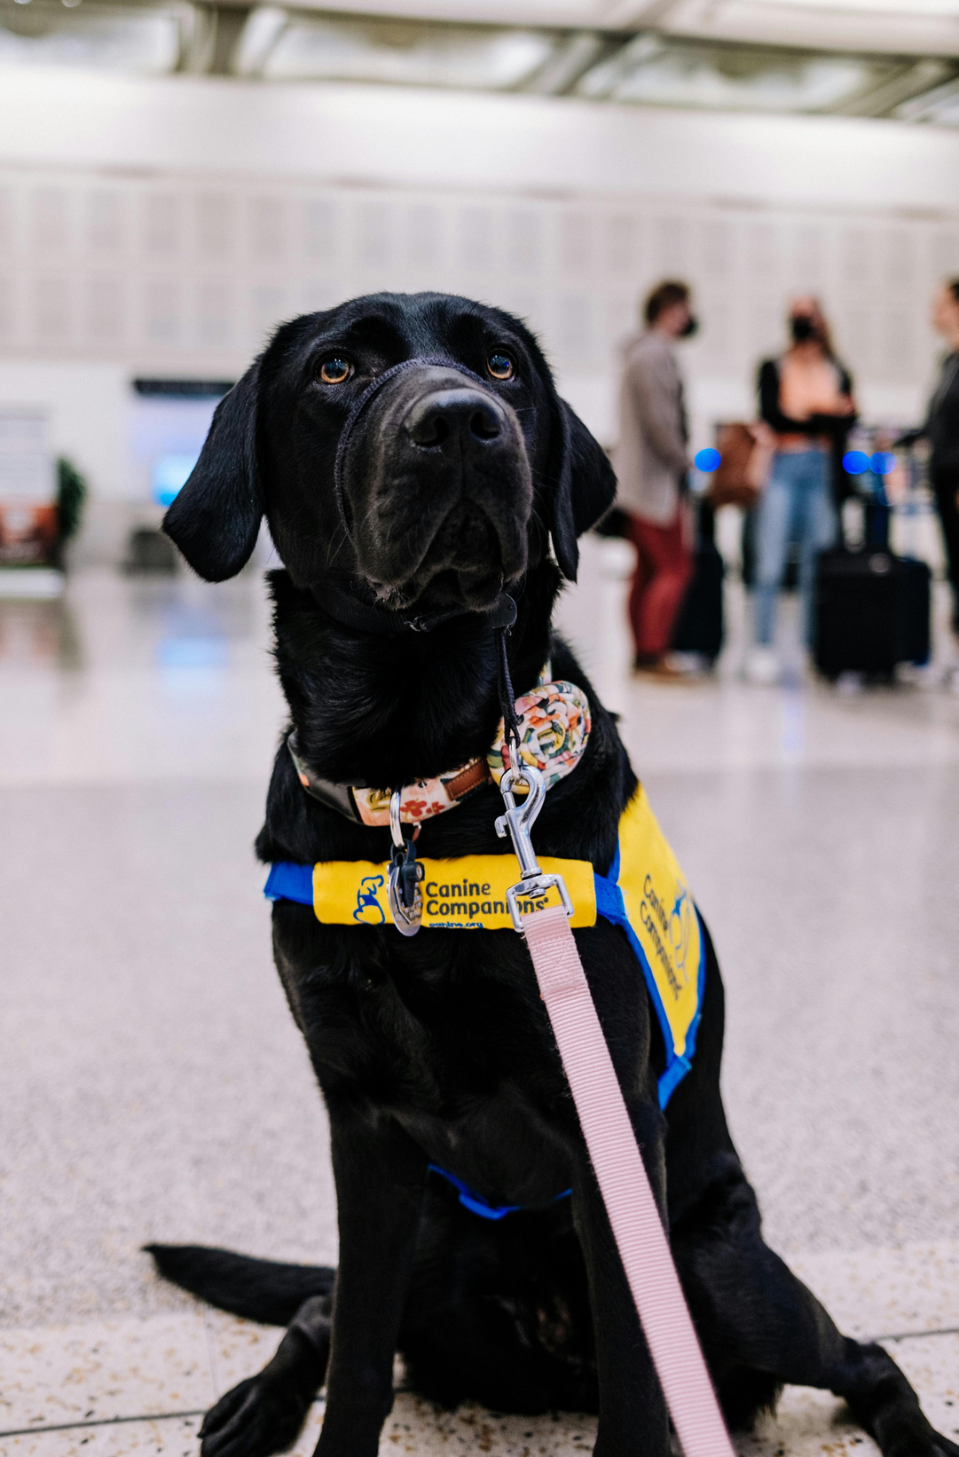
Disability/AFN Considerations
You may need to add extra supplies to your emergency kit to support your needs!
  Back up batteries for DME
  Safe foods
  Service animal supplies (food, water, harnesses)
  Puppy pads or similar
  Whistle/Signal device
  Sensory items
  Zip ties or rubber bands for quick identification
  Vital documents in accessible formats

Slide 16
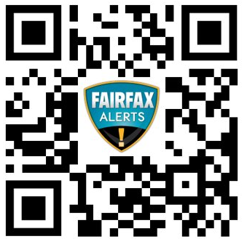
Step 4: Stay Informed
  Don’t wait for disaster to strike!
  Sign up for Fairfax Alerts
  Sign up for the Emergency Preparedness Newsletter
  Sign up for the Emergency Blog
  Follow @ReadyFairfax on social media

Slide 17
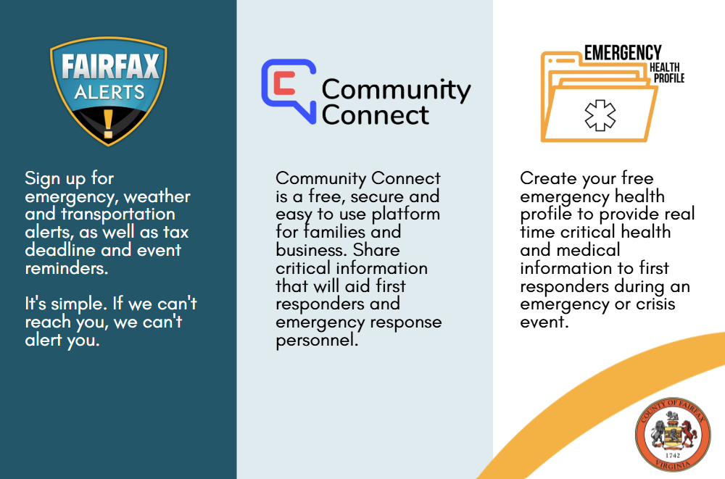
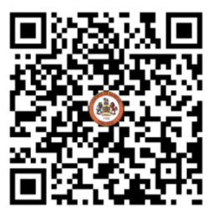
Register Today!

Slide 18
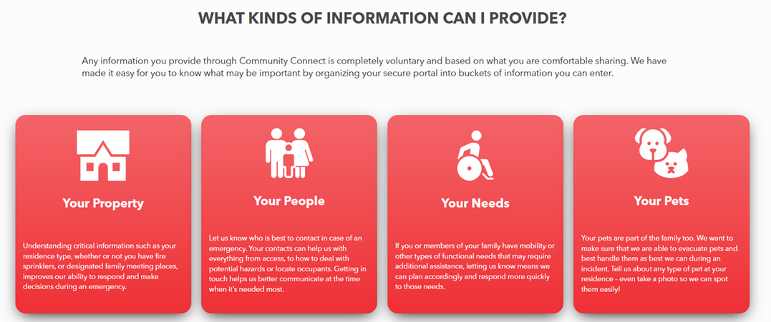
Resources
  Dominion Energy: electrically powered medical equipment form
  NOVEC: Serious medical condition certification
  Ready.gov/people-disabilities
  www.VAEmergency.gov/prepare/disabilities
  Community Connect: www.fairfaxcounty.gov/topics/alerts-and-emails

Slide 19







Step 5: Get Involved!

Slide 20

Questions?

Slide 21
Thank you!
Contact Information
DEMS Community Engagement Division
571-350-1000, TTY 711
DEMS-outreach@fairfaxcounty.gov

